Slide 1
BUSQOM 1080 Comparing Groups II
Fall 2020
Lecture 8
Professor: Michael Hamilton

Slide 2
Lecture Summary
Recap hypothesis testing from Lecture 7 [5 Mins]
Discuss tests for comparing means! Run them in R using t.test()
One sample t-test [10 Mins]
Two sample t-test [5 Mins]
Checking assumptions of t.tests, normality with qqplots
Normality assumptions with qqnorm() [5 Mins]
Independence assumption and paired two-sample t-test [5 Mins]
Examples! [5 Mins]

Slide 3
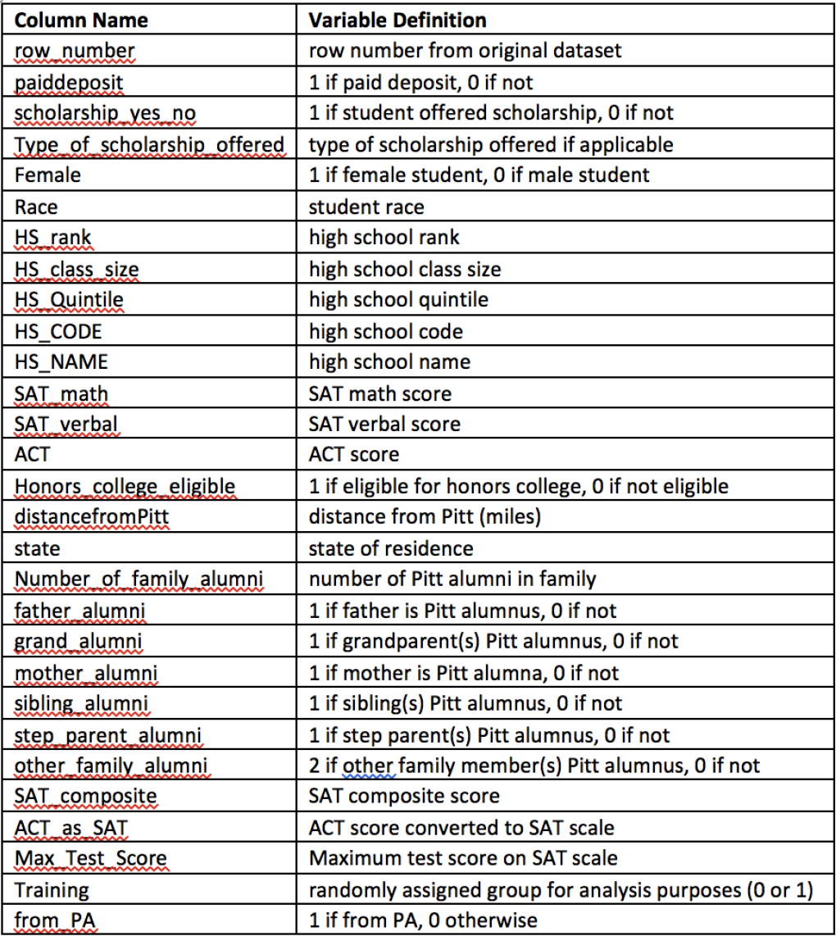
Data for Lecture
Save cba_admissions_1999.txt in your working directory
cba =read.table(“cba_admissions_1999.txt”, sep = "\t", header = T, quote = “”, allowEscapes = T)
880 obs of applicants to cba in 1999
Contains demographic info + scores

Slide 4
Hypothesis testing so far
Last time:
chisq.test() - Test for comparing counted against some expectation
binom.test() – Exact test proportions for binary counts
prop.test() – Application of chi.sq test to the special case of proportions across groups.
Last time we learned tests for counts categorical variables (factors), what about testing hypotheses involving numerical variables?
Today: Tests for comparison of means
Lengths of time (e.g., flight delays between airlines), money (e.g., sales between departments), distances (travel paths for bird migration), etc.

Slide 5
Lecture 7 Review
Type of Data | Test Application | Test | R function | Notes
Categorical Data | Compare group counts (one factor) | Chi-Squared Test | chisq.test(table of counts for one factor) | Any number of groups > 5 expected counts
 | Test if two factors are related | Chi-Squared Test | chisq.test(table of counts for two factors) OR chisq.test(factor variable 1, factor variable 2) | Any number of groups > 5 expected counts
 | One-sample test: compare one proportion to a given value | Binomial Test | binom.test(count of interest, sample size, p = test value, alternative, conf.level) | Exact test
 | Two sample test: compare proportions of two groups | Test for Proportions | prop.test(table of counts [rows = 2 groups and columns = 2 outcomes], alternative, conf.level) OR prop.test(group counts, group sample sizes, alternative, conf.level) | Limited to 2 groups Computes confidence interval
Notes: Parameters of .test() functions
alternative = “two.sided”, “greater”, or “less”
conf.level = X, X is usually 0.95, but any value between 0 and 1 is valid

Slide 6
Topic: Tests for Comparing Means
Application 1: Compare a mean to a specific value.
Example: Is the average flight delay significantly greater than 15 minutes?
Application 2: Compare means for two groups
Example: Are the average flight delay times significantly different for RegionEx and MDA?
Application 3: Compare means for more than 2 groups
Example: Does the average flight delay differ by day of the week?

Slide 7
General Framework of Hypothesis Testing
State hypothesis (and assumptions)
Observe a sample of data: X₁ , X₂ , … , X_{N}
Compute statistic: T = f(X₁ , X₂ , … , X_{N})
Based the hypothesis and possibly some assumptions about the data, know* the distribution of T, call it F.
Use F to measure the probability of T occurring under the hypothesis i.e. compute the p-value
Evaluate your hypothesis

Slide 8
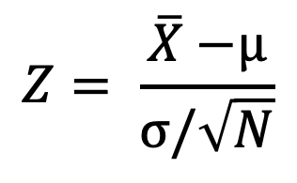
Motivation: t.tests (one sample)
Problem: Want to test if a sample drawn from an unknown Normal Distribution X₁ , X₂ , … , X_{N} ~ N(?, σ), has mean equal (or greater/less) to some number μ.
If we knew the true variance of the underlying dist. σ, we could compute a Z statistic:
If X₁ , X₂ , … , X_{N} are i.i.d. normal, Z is a standard normal random variable and we can easily compute p values.
$$Z= \frac{\overline{X}\text{ −}\text{μ}}{\text{σ}/\sqrt{N}}$$

Slide 9
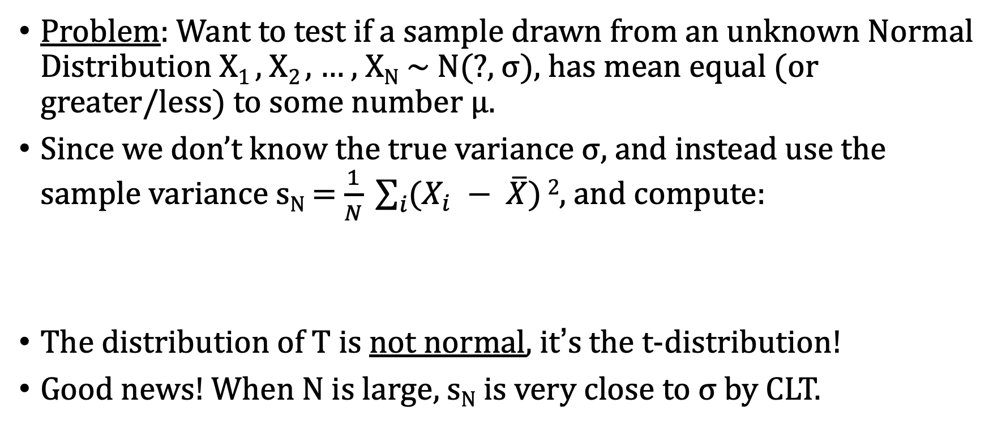
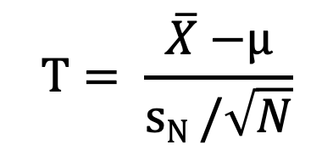
Motivation: t.tests (one sample)
Problem: Want to test if a sample drawn from an unknown Normal Distribution X₁ , X₂ , … , X_{N} ~ N(?, σ), has mean equal (or greater/less) to some number μ.
Since we don’t know the true variance σ, and instead use the sample variance s_{N} = $\frac{1}{N} \sum_{i}{(X_{i} − \overline{X})}2$, and compute:
The distribution of T is not normal, it’s the t-distribution!
Good news! When N is large, s_{N} is very close to σ by CLT.
$$T= \frac{\overline{X}\text{ −}\text{μ}}{\text{s}\text{N} /\sqrt{N}}$$

Slide 10
One sample t.test() in R
R will handle compute the t-distribution of statistic T
To do t-tests in R we use the t.test() function, that takes in a vector of numeric data and a null hypothesis.
Example
Using CBA data the average test score (Max_Test_Score) was 1158
Qu: Was the average test score among all students admitted to CBA less than 1200?

Slide 11
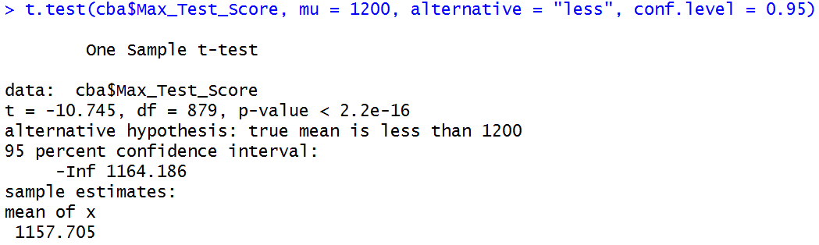
One sample t.test() in R
Qu: Was the average test score among all students admitted to CBA less than 1200?
Column to test
Value to test
“greater”, “less”, or “two.sided”
Level for confidence interval

Slide 12
One sample t.test() in R
Qu: Was the average test score among all students admitted to CBA less than 1200?
p-value for test
what we’re testing
confidence interval
(only relevant for two-sided test)
average is shown
Since the p-value is very small, stat. sign. evidence the mean is less 1200

Slide 13


Motivation: two sample t.tests
Problem: Want test if two samples drawn from an unknown Normal Distributions X₁ , X₂ , … , X_{N} ~ N(?, σ₁) and Y₁ , Y₂ , … , Y_{M} ~ N(?, σ₂) and have different means.
T statistic here is uses same idea, a little bit more complicated
It turns out this statistic T also has a t-distribution
$$s^{2}= \frac{\sum{{{(x}_{i}−\overline{X})}^{2}}\text{ + }\sum{{{(y}_{i}−\overline{Y})}^{2}}}{N+M −2}$$
T $= \frac{\overline{X}\text{ − }\overline{Y} }{\sqrt{s^{2}(\frac{1}{N}+ \frac{1}{M})}}$

Slide 14
Two sample t.test() in R
The format of the R command is:
t.test(numeric variable ~ grouping variable, alternative, conf.level)
Example
Qu: Are the avg. test scores different for students who paid deposits versus students who did not?

Slide 15
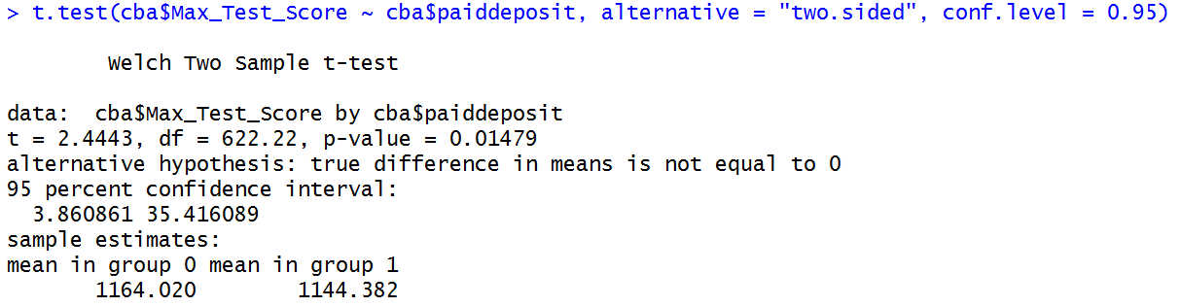
Two sample t.test() in R
Qu: Are the avg. test scores different for students who paid deposits versus students who did not?
Numeric column
to test
Grouping variable
(2 values)
“greater”, “less”, or “two.sided”
Level for confidence interval

Slide 16
Two sample t.test() in R
Qu: Are the avg. test scores different for students who paid deposits versus students who did not?
p-value for test
what we’re testing
confidence interval
(only relevant for two-sided test)
Averages for two groups shown
Since the p-value is close to 0.01, the two means are stat. sign. diff.

Slide 17
Assumptions for t-tests
Normally Distributed Data
Both groups should consist of independent draws from Normal distributions!
Tip: When number of samples is big it’s a not a big deal if normality is violated
Independence between groups, and samples
Possible problems:
Cluster effect: Data collected in subgroups
Serial effect: Measurements taken close together in time tend to be more similar than those taken at distant time points
Spatial correlation: Same idea as serial correlation but over space instead of time
Measurement before and after some treatment!

Slide 18
Assumptions for t-tests: Normality
Check qqplot of data using qqnorm() command.
Plots the quantiles of the data,
Rule: If not diagonal, then data is not normal!
Example: > qqnorm(cba$SAT_math)
If violated, report so. May need to use a
a data transformation (more on this after
the midterm!)

Slide 19
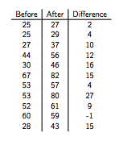
Assumptions for t-tests: Independence
What about when samples aren’t independent across groups?
In many applications data is taken before and after a treatment, on the same set of individuals
Group 1 (before): X₁ , X₂ , … , X_{N}
Group 2 (after): X₁+D₁ , X₂ + D₂ , … , X_{N} + D_{N}
Issue: If X’s and D’s are independent,
var(X+D) = var(X) + var(D) > var(D)
This affects how we compute our sample variances, don’t want to double count the variance from X.

Slide 20
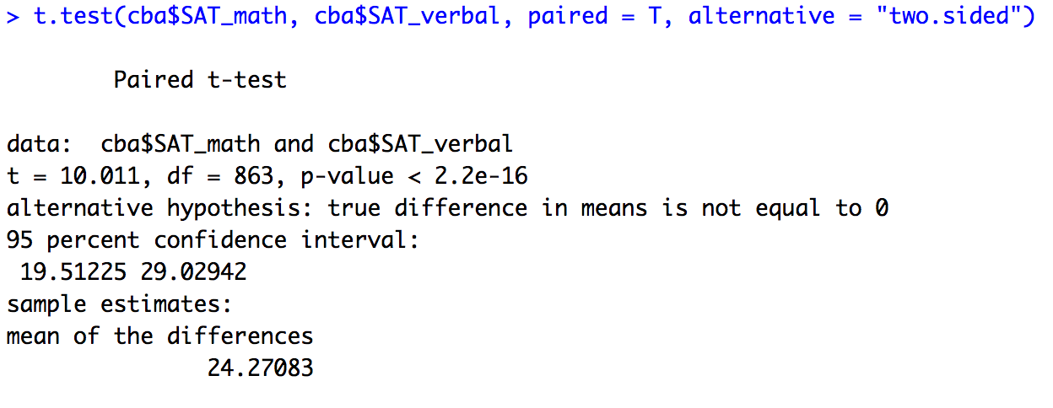
Topic: Paired t-test
One way independence can be violated is when the samples are “paired” i.e. the obs. in the two samples are in correspondence like in the previous slides example. In this case use a paired t.test().

Slide 21
Topic: the effect of outliers on t.tests
Since t-tests are based on means, extreme outliers and other data changes may significantly affect the results!
Not resistant to changes in part of the data
While slight non-normality can be okay, outliers can be disastrous!
May choose to analyze data with and without outliers and compare results, more on this as well after the midterm.

Slide 22
Review
Type of Data | Test Application | Test for Means (Normal Distribution) | R function
Numeric Data | One-sample test: compare mean or median to a given value | t-test for population mean | t.test(numeric variable, mu = test value, alternative, conf.level)
 | Two sample test: compare means or medians of two groups | t-test for the difference between group | t.test(numeric variable ~ grouping variable, alternative, conf.level)
Notes:
alternative = “two.sided”, “greater”, or “less”
conf.level = usually 0.95, but any value between 0 and 1
conf.int = TRUE or FALSE

Slide 23
Group Activity: Using the t.test() function
Load FriendFoe data: Data from the TV Game Show “Friend or Foe?”
Enter the following commands in R:
library(Ecdat)
?FriendFoe
View(FriendFoe)
str(FriendFoe)

Slide 24
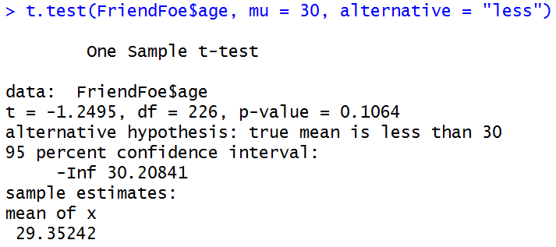
Question 1: Is the average age of contestants less than 30?
t.test(FriendFoe$age, mu = 30, alternative = “less”)
Since the p-value > 0.10, there is not enough evidence to suggest that the average age of contestants is less than 30.

Slide 25
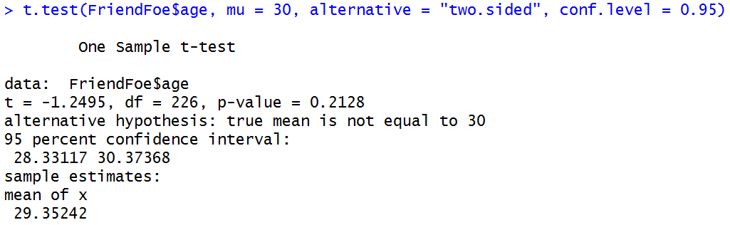
Question 2: What is a plausible range for the average age of contestants? Use a 95% confidence interval
t.test(FriendFoe$age, mu = 30, alternative = “two.sided”, conf.level = 0.95)
The 95% confidence interval for contestants’ average age is 28.33 – 30.37

Slide 26
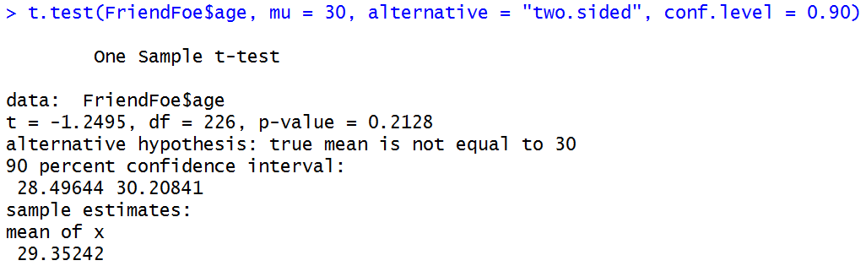

What happens if you change the confidence level?
Try 90%
Confidence interval is narrower (28.50 – 30.21)
What do you think will happen if we use 98%? 99%?

Slide 27
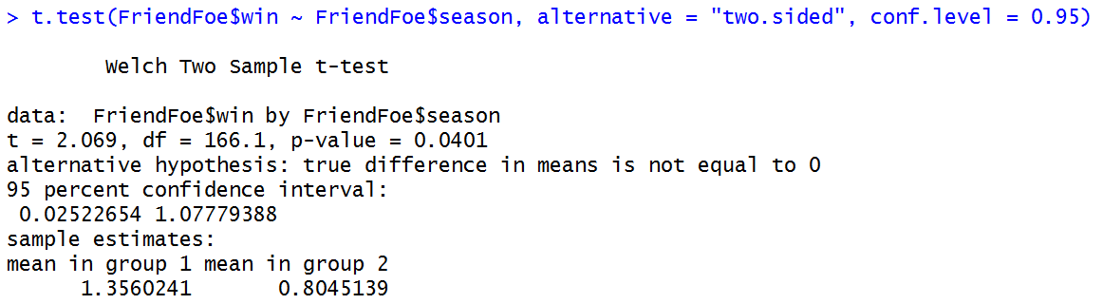
Question 3: Was the average amount of money won by the contestants different for the two seasons?
t.test(FriendFoe$win ~ FriendFoe$season, alternative = "two.sided", conf.level = 0.95)

